Slide 1
Pattern Languages
Robert Hanmer
Lucent Technologies
Naperville, Illinois, USA
hanmer@lucent.com

Slide 2
Introduction
“Each concrete building problem has a language. The town as an entirety has a language. And each building task within the town has its own language.”
        Christopher Alexander, The Timeless Way Of Building (TTWOB), p 358.
“Every person has a pattern language in his mind…At the moment when a person is faced with an act of design, he does not have time to think about it from scratch.”
        TTWOB, pp 202, 204.

Slide 3
Overview/outline
Introduction
What is a pattern
What are pattern languages
How are pattern languages used
How are pattern languages created
Summary
References

Slide 4
Objectives
At the end of this tutorial you will be able to
  Explain what makes up a pattern language
  Discuss how to use a pattern language
    For a new design
    For maintenance
  Discuss a process for creating a pattern language

Slide 5
Christopher Alexander
Building architect and theorist
Many books on architecture and art:
  A Pattern Language
  The Timeless Way of Building
  The Oregon Experiment
  The Production of Houses
  A Foreshadowing of 21st Century Art -- The Color and Geometry of Very Early Turkish Carpets
  The Nature of Order
http://www.patternlanguage.com

Slide 6


Handbook Model
The Handbook Model
  Patterns available in reference book easily accessible to designers
  No need to memorize all the details -- the reference book is available

Slide 7
What is a Pattern?

Slide 8
What is a pattern?
A form of documentation for recurring solutions
A pattern describes A solution to a problem and its relevant context
A pattern both describes a particular example and also provides enough information to recreate it
A pattern discusses and balances the tradeoffs present in the problem

Slide 9
Parts of a Pattern
Essential sections:
  Context
  Problem
  Forces
  Solution
Sections usually present:
  Resulting Context
  Rationale
These sections reflect the “Canonical” or “Coplien” form.
  This information will be present in a pattern regardless of the pattern form.

Slide 10
Pattern: Leaky Bucket Counters
Context: A system that is intended to recognize and correct problems automatically. In this environment the system needs to know if a problem is something that comes and goes intermittently , or only happens once, i.e. is "transient"; or is a repeating hard fault that needs to be corrected. Humidity, heat, and other environmental problems cause transient errors, which should be treated differently than hard faults.
Problem: How do you know if a fault is transient or intermittent (e.g. errors caused by excessive humidity or nearby lightening strikes)?
Forces: You want a hardware module to exhibit `hard' failures before taking drastic action. Some failures are not `hard' and come from the environment and thus should not be blamed on the device.

Slide 11

Leaky Bucket Counters (2)
Solution: Each failure group that is to be watched has a counter (the leaky bucket counter) which is initialized to a predetermined value when the system is first initialized. The counter is incremented for each error or fault detected. The counter is decremented on a periodic timed basis, but will never be decremented beyond its initial value.
A counter incrementing past a pre-determined threshold value indicates that the rate of error or fault events exceeds the allowable rate (as defined by the empty or leak rate, rate of errors and threshold value). This should be taken as an indication that the fault is not transient or intermittent.
Sketch:

Slide 12
Leaky Bucket Counters (3)
Resulting Context: A system in which errors are isolated and handled (by taking devices out of service), but transient errors don't cause unnecessary loss of service.
Author: by Robert Gamoke, generalized by Robert Hanmer, original version edited by James O. Coplien published in Pattern Languages of Programming - 2, chapter 33. Very similar to Leaky Bucket of Credit by Gerard Meszaros published in Pattern Languages of Programming - 2, chapter 35. Leaky Bucket of Credit describes using this same concept as a resource allocation mechanism.

Slide 13
What is a Pattern Language?

Slide 14
Pattern Languages
Individual Patterns are useful, but . . .
they are most powerful when combined into a language
“Each pattern then, depends both on the smaller patterns it contains, and on the larger patterns within which it is contained.”
        TTWOB, p 312.

Slide 15
What is a Pattern Language?
A collection of patterns that work together
A collection of patterns that build upon each other to build something bigger than any of the individual patterns can build
“All acts of building are governed by a pattern language of some sort.”
        TTWOB, p 193

Slide 16
Suggested Parts of a Pattern Language (overview)
Language intent
  A short description of what the language is intended to accomplish
  Like an abstract for the language
Language map
  A diagram that shows an example of how the patterns build upon and relate to each other
Language description
  A description of how the pattern language is morphologically and functionally complete
The Patterns that make up the language

Slide 17
Example Pattern Language
Telecom IO
  A specialized set of patterns for defining the human-machine interface has come into use with the world of telecommunications witching products. These patterns provide an essential interface between a system and its human masters.

Slide 18
Example Pattern Language
Telecom I/O
  MML
  IO Gatekeeper
  George Washington is still dead
  IO Triage
  Timestamp
  The Bottom Line
  Five Minutes of No Escalation Messages
  Mind Your Own Business
  Pseudo-IO
  Who Asked?
  Beltline Terminal
  Audible Alarm
  Alarm Grid
  People Know Best
  Office Alarms
  String A Wire
  Don’t Let Them Forget
  Raw IO

Slide 19
Telecom IO Pattern Intents
Alarm Grid | Group alarms into grids to help the workers identify problems.
Audible Alarms | Sound audible alarms to alert office personnel of problems.
Beltline Terminal | Allow workers to take their terminals with them.
Don't Let Them Forget | Reassert alarms when necessary, purposely forgetting requests to retire the alarms.
Five Minutes of No Escalation Messages | Don't confuse craft with too frequent messages.
George Washington is Still Dead | Issue state change messages only when the state changes, not to remind about the current state.
IO Gatekeeper | Put one process in charge of IO for the system.
IO Triage | Add a priority tag to each output message and sort the output using them.
Mind Your Own Business | Only send output to concerned terminal groups (logical channels).
MML | Use a standardized IO language.
Office Alarms | Allow the alarm system to be customizable with site specific alarms.
Pseudo-IO | Provide for internal subsystems to add IO to the stream.
Raw I/O | Provide a way for recovery systems to bypass the IO Gatekeeper.
Shut Up And Listen | Give human input/output messages a high priority.
String A Wire | Provide a system to system emergency information channel.
The Bottom Line | Issue messages to summarize a number of events rather than for each of many events.
Timestamp | Add a timestamp and/or a sequence number to each output message.
Who Asked? | Return output only to the logical channel/terminal that requested it.

Slide 20
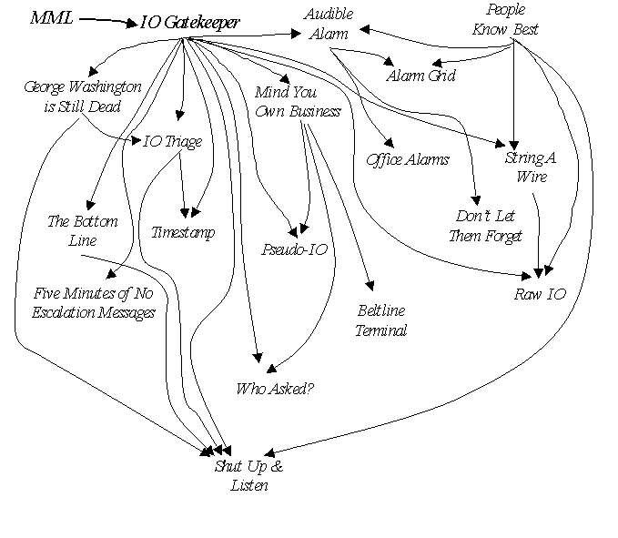
Example Pattern Language
Telecom I/O
PLoPD-4

Slide 21
How do the patterns in a language work together?
Each pattern builds upon the patterns that came previously.
Each pattern creates the context for the following patterns.
Each larger pattern contains the lower level patterns

Slide 22
Pattern Languages
Pattern languages must be complete in two ways
  Morphologically
    Patterns fit together to form a complete structure without gaps.
  Functionally
    Any new forces introduced by the patterns are resolved by the patterns themselves.
If they are not complete in these ways we refer to them as a “collection”
  The GOF and POSA books are collections

Slide 23
Morphological Completeness
“A language is morphologically complete when I can visualize the kind of buildings which it generates very concretely.”
        TTWOB, p 316.
Example:
  From Telecom IO you see a system with these attributes:
    Text based
    Large volumes of output is processed, labeled, sorted, distributed
    Ways to get the technician’s attention exist
    Ways to reduce the stress level and sometimes the workload of the technician are present
Notes:
From: http://dictionary.reference.com/search?q=morphological
mor·phol·o·gy P Pronunciation Key (môr-f l -j )
n. pl. mor·phol·o·gies
The branch of biology that deals with the form and structure of organisms without consideration of function.
The form and structure of an organism or one of its parts: the morphology of a cell; the morphology of vertebrates.
Linguistics. The study of the structure and form of words in language or a language, including inflection, derivation, and the formation of compounds.
mor pho·log i·cal (-f -l j -k l) or mor pho·log ic adj.
mor pho·log i·cal·ly adv.
mor·phol o·gist n.

Slide 24
Functional Completeness
All the internal forces are resolved.
  When patterns are applied they introduce new forces.
  A language is functionally complete when these internal forces are covered.
Example:
  From Telecom IO: Audible Alarms can drive the technician crazy with the noise. A solution to which is the way to silence the alarm. But that introduces the problem of the technician ignoring/forgetting about the alarm. This force can be resolved with Don’t Let Them Forget, also in the language.

Slide 25
Languages Change with the Problems
The introduction of new external requirements (forces) can change the needs of the language.
  When the problem changes, the patterns in the existing language might not cover all of the new forces.
Example:
  The desire to remotely monitor a system’s alarms will require solutions not described by any pattern in the Telecom IO language.

Slide 26
Parts of a Pattern Language
Title
Language Intent
  A short description of what the language is intended to accomplish
  Like an abstract for the language
Language Map
  A diagram that shows how the patterns build upon and relate to each other
Language Description
  A description of how the pattern language is morphologically and functionally complete
The Patterns that make up the language

Slide 27
Language Abstract
A short description of what the language is intended to accomplish
Like an abstract for the language
CHECKS by Ward Cunningham
  “Any program that accepts user input needs to separate good input from bad and make sure that little of the latter gest recorded. The CHECKS pattern language tells how to make such checks without complicating programs and comprising future flexibility.”
        PLOPD, p 144.
Notes:
CHECKS used with permission of Ward Cunningham.

Slide 28
Language diagrams
A diagram that shows how the patterns build upon and relate to each other
Directed Acyclic Graph (DAG)
A and B must be applied before C
Applying C indicates that D should be applied
A, B and C must be applied before D
Pattern A
Pattern B
Pattern C
Pattern D

Slide 29
Example Language Map
Telecom I/O Pattern Language
PLoPD-4

Slide 30
Language Description
A description of the pattern language to help the reader visualize the completeness of the language (both morphologically and functionally)
How do the patterns work together?
  A description in words of the Language Map
CHECKS:
  “The language has eleven patterns presented in three sections. The first section describes values as they should be captured by the user-interface and used within the domain model. The second and third sections discuss detecting and correcting mistakes, first during data entry and then after posting or publication. The patterns draw from the author's experience developing financial software in Smalltalk. They are written as if part of a larger language and therefore may seem sketchy or incomplete. This paper is as much an experiment in the selection and linking of patterns as an attempt to communicate practical knowledge.”
        PLOPD, p 145, PPR.

Slide 31
Patterns
Various pattern forms, each will be handled slightly differently.
The reader of the patterns in the pattern language should be led from one pattern to another.
  From the resulting context of one ………… To the context of the next
Telecom I/O:
  In IO Triage’s Resulting Context: “The most important information will be displayed first, followed by less important and possibly quite old information. This requires the IO Gatekeeper to prepare messages for display in the desired order. Use a message sequence tag to facilitate a complete understanding of the system state (see Timestamp).
  In Timestamp’s Context: IO Triage has been applied. Messages may not come out in the strict order requested by subsystems.

Slide 32
Example Language: CHECKS
Section 1. First consider quantities used by the domain model. Your domain code must
1. Whole Value
2. Exceptional Value
3. Meaningless Behavior
Section 2. A person reaches through a program's interface to manipulate the domain model.
4. Echo Back
5. Visible Implication
6. Deferred Validation
7. Instant Projection
8. Hypothetical Publication
Section 3. Now consider mechanisms that address the long term integrity of information.
9. Forecast Confirmation
10. Diagnostic Query
      PLOPD, pp145-155, PPR.

Slide 33
9. Forecast Confirmation
PLOPD p. 154, PPR.
Events in the world often run ahead of those modeled in a computer system. When events can be anticipated, it makes sense to mechanically generate their models and to publish them for public use. However, when the computer system does catch up with reality, it is important that reality is accurately modeled.
Therefore: Provide a mechanism for adjusting and confirming values associated with mechanically published events. Consider the sequence:
  Thursday: we predict an automatic deposit of 187,655.47 for Friday
  Friday: we mechanically post 187,655.47 to the cash account
  Monday: bank records show 187,655.50 was deposited on Friday, we adjust accordingly
  Later: records for the month are closed showing no unusual activity
What is important here is that the best information was available at every moment even though no one was technically accountable for the posting until after the fact. Forecast Confirmations look like original entries from the point of view of accounting integrity.
Forecast Confirmations only apply to mechanically generated models. Once confirmed, the model's values become subject to accounting integrity.

Slide 34
POSA 2 Language Style
Pattern Descriptions are written in a stand-alone manner.
The pattern language description shows a map of the language
A language description weaves the stand-alone pattern text into a language.
From within the Strategized Locking language description:
  “The Scoped Locking idiom (325) can be used to acquire and release a particular type of lock that is parameterized into a component via the Strategized Locking pattern.” (POSA2, p 519)

Slide 35
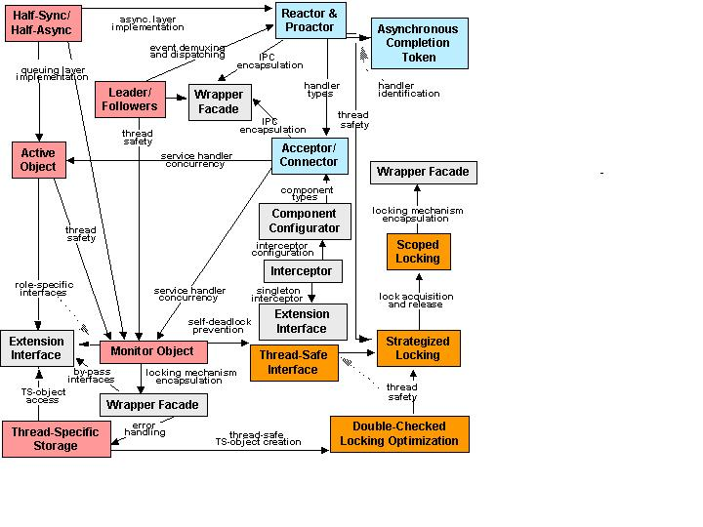

Pattern Benefits
  Preserve crucial design information used by applications & middleware frameworks & components
  Facilitate reuse of proven software designs & architectures
  Guide design choices for application developers
Notes:
POSA2 Language slides used with permission of Doug Schmidt.

Slide 36
POSA2 Pattern Abstracts
Service Access & Configuration Patterns
The Wrapper Facade design pattern encapsulates the functions and data provided by existing non-object-oriented APIs within more concise, robust, portable, maintainable, and cohesive object-oriented class interfaces.
The Component Configurator design pattern allows an application to link and unlink its component implementations at run-time without having to modify, recompile, or statically relink the application. Component Configurator further supports the reconfiguration of components into different application processes without having to shut down and re-start running processes.
The Interceptor architectural pattern allows services to be added transparently to a framework and triggered automatically when certain events occur.
The Extension Interface design pattern allows multiple interfaces to be exported by a component, to prevent bloating of interfaces and breaking of client code when developers extend or modify the functionality of the component.
Event Handling Patterns
The Reactor architectural pattern allows event-driven applications to demultiplex and dispatch service requests that are delivered to an application from one or more clients.
The Proactor architectural pattern allows event-driven applications to efficiently demultiplex and dispatch service requests triggered by the completion of asynchronous operations, to achieve the performance benefits of concurrency without incurring certain of its liabilities.
The Asynchronous Completion Token design pattern allows an application to demultiplex and process efficiently the responses of asynchronous operations it invokes on services.
The Acceptor-Connector design pattern decouples the connection and initialization of cooperating peer services in a networked system from the processing performed by the peer services after they are connected and initialized.

Slide 37
POSA2 Pattern Abstracts (cont’d)
Synchronization Patterns
The Scoped Locking C++ idiom ensures that a lock is acquired when control enters a scope and released automatically when control leaves the scope, regardless of the return path from the scope.
The Strategized Locking design pattern parameterizes synchronization mechanisms that protect a component’s critical sections from concurrent access.
The Thread-Safe Interface design pattern minimizes locking overhead and ensures that intra-component method calls do not incur ‘self-deadlock’ by trying to reacquire a lock that is held by the component already.
The Double-Checked Locking Optimization design pattern reduces contention and synchronization overhead whenever critical sections of code must acquire locks in a thread-safe manner just once during program execution.2
Concurrency Patterns
The Active Object design pattern decouples method execution from method invocation to enhance concurrency and simplify synchronized access to objects that reside in their own threads of control.
The Monitor Object design pattern synchronizes concurrent method execution to ensure that only one method at a time runs within an object. It also allows an object’s methods to cooperatively schedule their execution sequences.
The Half-Sync/Half-Async architectural pattern decouples asynchronous and synchronous service processing in concurrent systems, to simplify programming without unduly reducing performance. The pattern introduces two intercommunicating layers, one for asynchronous and one for synchronous service processing.
The Leader/Followers architectural pattern provides an efficient concurrency model where multiple threads take turns sharing a set of event sources in order to detect, demultiplex, dispatch, and process service requests that occur on the event sources.
The Thread-Specific Storage design pattern allows multiple threads to use one ‘logically global’ access point to retrieve an object that is local to a thread, without incurring locking overhead on each object access.

Slide 38
How are Pattern Languages Used?

Slide 39
“Never the same way twice.”
Applying a pattern language is not a “turn the crank” exercise.
Every application of patterns or pattern languages must be customized for the situation at hand.
  Every situation poses unique problems.
  Every situation requires a unique solution.
The pattern maps described earlier represent just one way that the patterns can be combined to create a solution.

Slide 40
Architectural Documentation
Patterns are useful to document built systems.
  Allows maintenance engineers a snapshot of the designer’s thinking.
  Points out to the future maintainers/enhancers where the “load bearing walls” are.
  Parnas & Clements: “A Rational Design Process: How and Why to Fake It”.
Beck & Johnson: “Patterns Generate Architecture”
4ESS Switch project in Lucent Technologies
  Design begun early 1970’s. First office application January 1976.
  New enhancements still being added.
  Uses patterns document key principles.

Slide 41
Architectural Training Materials
Using a pattern language to describe an architecture can effectively train new people.
  Helps people understand why things were built in a certain way, not just what was built.
4ESS Switch refresher training with a pattern language.
  Students felt effective regardless of previous experience.
  (Hanmer, 2002)

Slide 42
Impress Your Friends
Pattern languages are cool, aren’t they?
But do they really extend the literature?
Think before writing … will this be helpful? Who will benefit from this?
  (This will help your writing in general!)

Slide 43
Design Aid
If you were designing an alarm component for a system, the Telecom IO Alarm patterns might be helpful.
  Alarm Grid
  Audible Alarm
  Office Alarms
  Don’t Let Them Forget
By examining these patterns you will see how to build such a component, and the order in which you should think about using them.

Slide 44
Collecting the Relevant Patterns
When starting a project that patterns and pattern languages might be useful for:
Assemble the relevant patterns
  Example: to build a garden, Alexander suggests these patterns:
Half-Hidden Garden
Terraced Slope
Fruit Trees
Tree Places
Garden Growing Wild
Entrance Transition
Courtyards Which Live
Roof Garden
Building Edge
Sunny Place
Outdoor Room
Six-Foot Balcony
Connection to the Earth
Greenhouse
Garden Seat
TTWOB, p 310

Slide 45
How do I find the patterns I need for this project?
Pattern Almanac
  Lists all the patterns published up to mid-2000.
Web
  Many websites that contain links to patterns exist now.
    Hillside.net
    Patternscentral.com
PLOP proceedings and PLOPD books
Specialized tutorials
Basically: be familiar with Handbook

Slide 46
Design
Decide what is topmost pattern
  Apply it
  It will lead to other patterns that need to be applied quickly
    E.g. add a queue → need to define the queuing strategy (LIFO, FIFO) now rather than deferring it forever

Slide 47
Continue designing until done
Step through the sequence of patterns.
Apply each pattern in turn.
Stepping from one to those that complete it and return to those larger ones that need application.
“Each pattern then, depends both on the smaller patterns it contains, and on the larger patterns within which it is contained.”
        TTWOB, p 312.

Slide 48
Documenting a Pattern Language

Slide 49
Not a One Step Process
“… don’t count on being able to ‘mine’ a pattern language’ A pattern language comes together like a jigsaw puzzle from patterns that have been collected over months, years or decades. At some point it becomes publishable, but its evolution doesn’t cease at that same point.”
        Coplien, C++ Report: Pattern Languages

Slide 50
Languages Grow
In Telecom IO there are three patterns that describe much the same problem: Dealing with too much output
  George Washington is Still Dead (aka Show Changes)
  The Bottom Line
  Five Minutes of No Escalation Messages
When the system has a mediator of the output channel (IO Gatekeeper) this forms a little language.
But there are other forces introduced as it progresses.
This mini-language evolved into a larger language.

Slide 51
Getting started
From Coplien: Pay attention to:
  The context
  And forces of the individual patterns
  Simple organizing principles
        C++ Report: Pattern Languages
From POSA2:
  Identify pattern relationships
  Define pattern ordering

Slide 52
What is related?
What is required for this pattern to work?
What if absent would mean that this cannot work?
What’s missing?
“When every pattern has its principle components given by the smaller patterns which lie immediately below it in the language, then the language is complete.”
        TTWOB, p 322.

Slide 53
Example
Resulting Context of Audible Alarm:
  “A method of silencing the alarms by manual action needs to be implemented. This allows the craft to have some peace and quiet while they try to isolate the problem …”
What problems does this introduce?
How should it be resolved?

Slide 54
Example (2)
Add a reference to the pattern Don’t Let them Forget
  “… Now that they have a method to silence the alarms, Don’t Let Them Forget that the alarm happened and that there is something needing their attention.”
And add the pattern Don’t Let Them Forget to the language.
Audible Alarms
Don’t Let Them Forget

Slide 55
Another Example
Real Time and Resource Overload
  Workshopped at PLOP 2000 conference.
Intent: A system that reacts to externally provided stimuli might receive more stimuli than it can handle at any given time. When this "overload" situation occurs the system must be able to deal with it somehow. Many systems respond by ceasing all work, i.e. locking up or crashing. A well-designed system is able to handle the overload and respond gracefully to the excess stimuli. This system might have somewhat reduced capabilities during the transition, but it will correctly handle much of the work presented to it, and when stimuli levels return to normal, it can resume full functionality with minimal involvement.

Slide 56
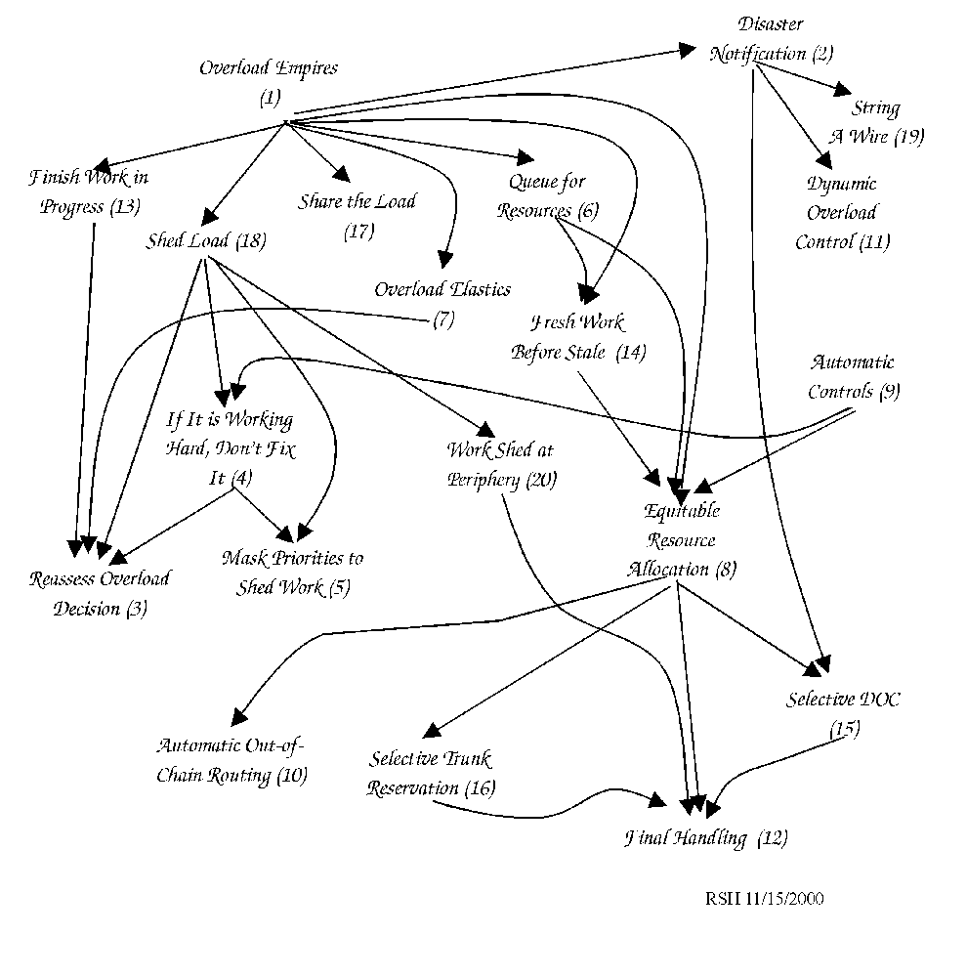
Real Time and Resource Overload
PLoP 2000

Slide 57
Real Time & Resource Overload
What’s missing?
Overload Empires talks about the problem/solution domains of different types of resources: Memory, Real-time, non-memory resources.
Patterns in the language talk about
  Real Time: Fresh Work before Stale, Shed Work at Periphery
  Non-Memory: Equitable Resource Allocation, Selective DOC
  Memory:
Memory patterns need to be added to complete this language functionally.

Slide 58
Pattern Refactoring
Real Time and Resource Overload is an example of pattern refactoring.
It combines patterns from 3 previous works into an (almost) language.
  Meszaros, “A Pattern Language for Improving the Capacity of Reactive Systems”, PLOPD-2, ch 35.
  Hanmer and Wu, “Traffic Congestion”, PLoP 1999 Proceedings.
  With String a Wire from Telecom IO thrown in also.

Slide 59
Pattern Refactoring (2)
The pattern you are about to write to complete a language might already have been written by someone else.
  Can you cite it and move on?
  Do you need to rephrase it (continuing to give the original authors credit of course) to fit in your language?

Slide 60
Summary

Slide 61
Summary
Pattern languages are a useful way to help
  Design
  Document
  Learn
Pattern languages capture the relationships of larger patterns that require smaller patterns to complete them.
Pattern language descriptions usually include:
  An abstract
  A description
  A map
  A collection of patterns

Slide 62
Summary (2)
Use a pattern language by
  Collecting the relevant patterns
  Deciding which needs to be applied first
  Apply the patterns as they are needed.
    From the largest to the smallest, working with the ones that are needed to complete the one just applied.
Document a pattern language by
  Paying attention
  Iteratively adding new parts
  Pulling in references to patterns written by others

Slide 63
References (1)
Alexander, C. et. al. A Pattern Language. New York: Oxford University Press. 1977.
Alexander, C. The Timeless Way of Building. New York: Oxford University Press. 1979.
Beck, K. and R. Johnson, “Patterns Generate Architectures,” Object-Oriented Programming 8th European Conference (ECOOP ’94), Springer-Verlag, 1994.
Buschmann, F., R. Meunier, H. Rohnert, P. Sommerlad, M. Stal. Pattern-Oriented Software Architecture - - A System of Patterns. West Sussex: John WIley and Sons. 1996.
Coplien, J. O. and D. C. Schmidt, eds. Pattern Languages of Program Design. Reading, MA: Addison-Wesley. 1995.
Coplien, J. O. Software Patterns. New York: SIGS Publications. 1996.
Coplien, J. O. “The Column Without a Name: Pattern Languages,” C++ Report, Vol. 9, No. 1, 1997, pp 15-21.
Cunningham, W. “The CHECKS Pattern Language of Information Integrity,” in [5], pp 145-155.
Gabriel, R. P. Patterns of Software. New York: Oxford University Press. 1996.
Gamma, E., R. Helm, R. Johnson and J. Vlissides. Design Patterns: Elements of Re-usable object-Oriented Design. Addison-Wesley. 1994.

Slide 64
References (2)
Hanmer, R. S., “Real Time and Resource Overload”, PLoP 2000 Proceedings.
Hanmer, R. S. and G. Stymfal, “An Input and Output Pattern Language: Lessons from Telecommunications”, in [14], pp 502-536.
Hanmer, R. S. “Using Patterns to Teach Software Architecture,” Proceedings of the 6th Biennial World Conference on Integrated Design and Process Technology, Pasadena, CA, June, 2002.
Harrison, N., B. Foote, H. Rohnert, eds. Pattern Languages of Program Design-4. Reading, MA: Addison-Wesley, 2000.
Meszaros, G, “A Pattern Language for Improving the Capacity of Reactive Systems”, in [19], pp 575-591.
Parnas, D. L. and P. C. Clements. “A Rational Design Process: How and Why to Fake It,” IEEE Transactions on Software Engineering, Vol. SE-12, No. 2, Feb. 1986, pp 251-257.
Rising, L. The Pattern Alamanac 2000. Reading, MA: Addison-Wesley, 2000.
Schmidt, D., M. Stal, H. Rohnert, and F. Buschmann. Pattern -Oriented Software Architecture Volume 2 -- Patterns for Concurrent and Networked Objects. West Sussex: John Wiley and Sons. 2000.
Vlissides, J., J. Coplien and N. Kerth, eds. Pattern Languages of Program Design-2. Reading, MA: Addison-Wesley, 1996.

